Slide 1


Skills and Economic Challenges in Cannock Chase
Skills and Employability Team,
Staffordshire County Council

Slide 2


Introduction
Provide insight into current and future skills demand and supply challenges in Cannock Chase

Slide 3



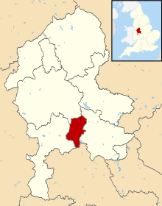
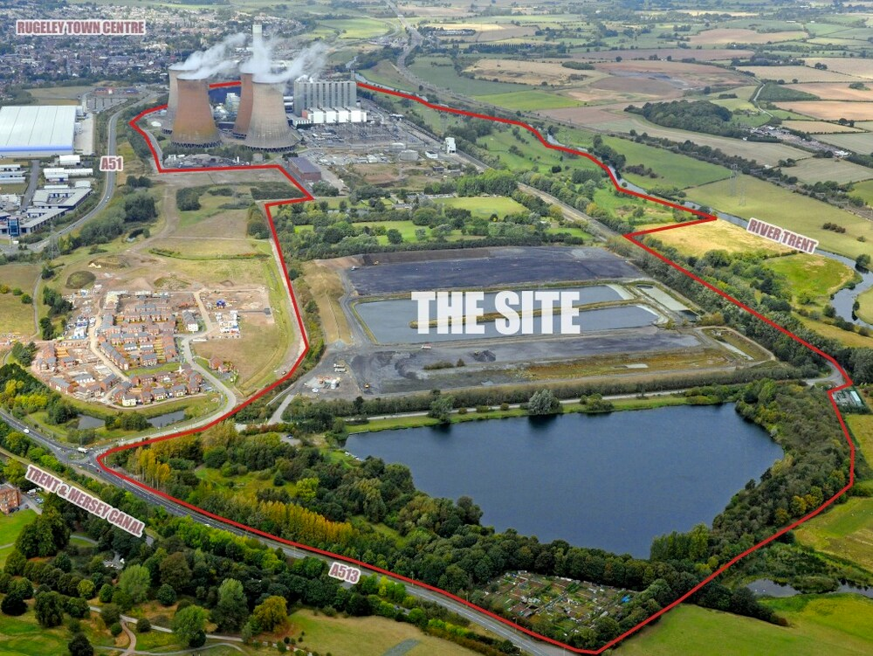




Recent success in creating new businesses and jobs
445 additional businesses since 2011
Business start-ups are higher than the Staffordshire average, with only Lichfield and East Staffordshire having an higher rate of start-ups, but still lags behind regional and national averages
However, businesses are less likely to fail
9,000 additional jobs since 2011
Highest increase in jobs of all Staffordshire LA’s and a higher rate of jobs growth than the regional and national averages
Notes:
Total Businesses – 3,385 in 2019 (Source: UK Business Counts)
Business start-up rates per 10,000 – Cannock Chase 48.1 / Staffordshire 47.1 / WM 66.0 / England 75.2
Business death rates per 10,000 - Cannock Chase 43.2 / Staffordshire 43.8 / WM 55.8 / England 65.9
3 Year business survival rates – Cannock Chase 56% / Staffordshire 59% / WM 56% / national 55% (declining trend across all areas)
(Source: ONS Business Demography 2018)
Jobs growth rate 2011-2018 = Cannock Chase highest (23.1%) of all Staffordshire LAs and above regional (12.3%) and national (13.5%) averages
Job density (jobs per working age pop) = low (0.76) compared to regional (0.81) and national (0.87) averages
(Source: ONS Job Density 2018)

Slide 4
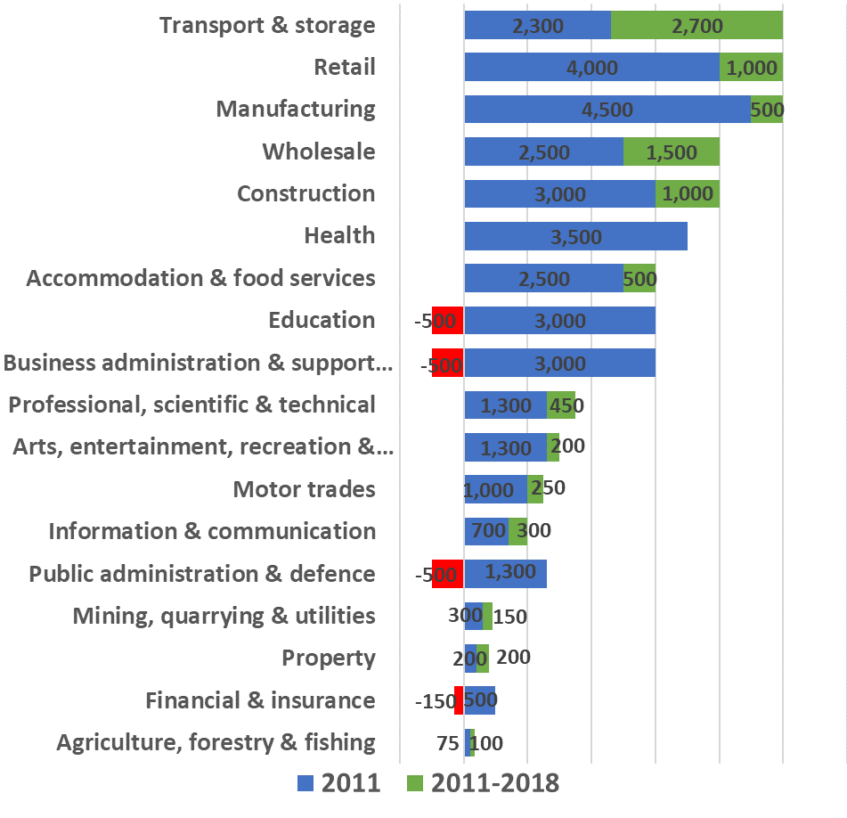
More balanced economy with jobs growth in service based industries and declines in public and financial sectors
42,000 jobs in 2018
Largest sectors are distribution, retail and manufacturing (5,000 jobs each)
Rebalanced the local economy – strong growth in distribution (+2,700) and retail & wholesale (+2,500)
Clear impact of the recession on the financial sector and ensuing austerity in public sector
An economy that feels more resilient to economic shocks…
Notes:
(Source: Business Register and Employment Survey (BRES) 2018)

Slide 5
Issues with unemployment and youth unemployment with both above the Staffordshire averages
Notes:
Claimant Count Rate (June 2020): 5.8% or 3,660 claiming JSA or Unemployment Universal Credit, above the Staffordshire (4.9%) average but below the national (6.4%) average (Source: DWP Claimant Count)
Economic Inactivity (Apr 2019-Mar 2020): lower level of economic inactivity than Staffordshire and national averages
Cannock Chase 14.1% / Staffordshire 18.0% / national 20.6% (Source: Annual Population Survey)
Youth Unemployment (aged 18-24) (June 2020): Higher rate of young people (aged 18-24) finding themselves unemployed than the Staffordshire and national averages - Cannock Chase 10.9% / Staffordshire 8.3% / national 9.1% - 800 18-24 claimants in June 2020 (Source: DWP Claimant Count)

Slide 6
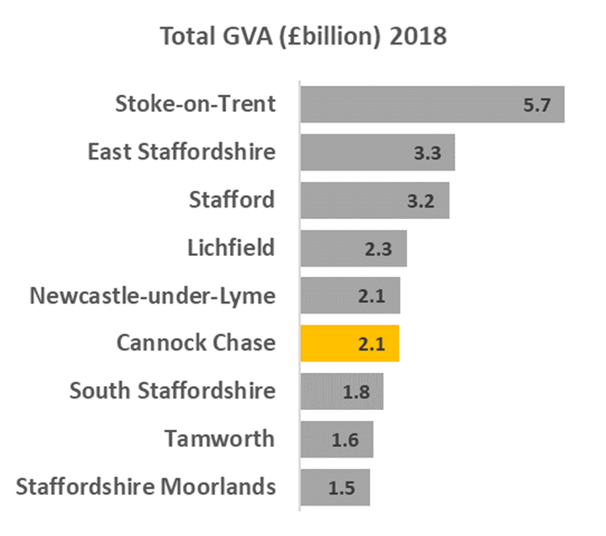
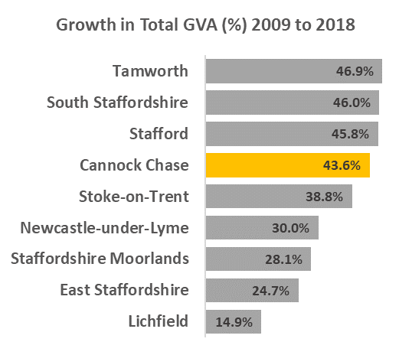
Higher than average growth in the economy, driven mainly by jobs growth in construction, distribution and wholesale & retail
WM = 43.4%
UK = 35.5%
Staffs = 33.4%
Notes:
Size of economy 2018: £2.1billion
GVA growth 2009-2018:
Total £646million (43.6%)
Construction £161million
Distribution £160m (Amazon)
Wholesale and Retail £119m
(All seen an increase in jobs)
(Source: ONS Regional gross value added (balanced) by local authority 2018)

Slide 7
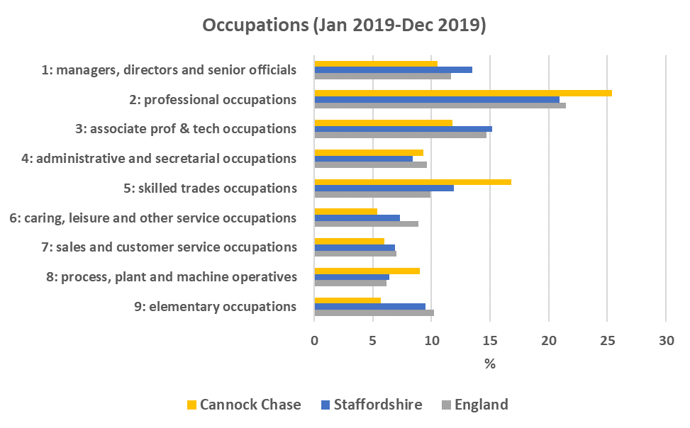
Cannock Chase is in-line with the national average for jobs in higher occupations
Nearly half (48%) of jobs in Cannock Chase were in the top 3 occupation groups in 2019, which was the same proportion as nationally but slightly lower than the Staffordshire average of 50%
Notes:
Occupations (2019):
Increase in the % of jobs in the top 3 occupation groups from 29% in 2009 to 48% in 2019 equivalent to over double (106%) or 12,900 more residents employed in these higher occupations putting it in-line with the national average but still slightly below the Staffordshire (50%) average
(The top three occupation groups are: ‘managers, directors and senior officials’, ‘professional occupations’ and ‘associate professional & technical occupations’)
(Source: Annual Population Survey)

Slide 8
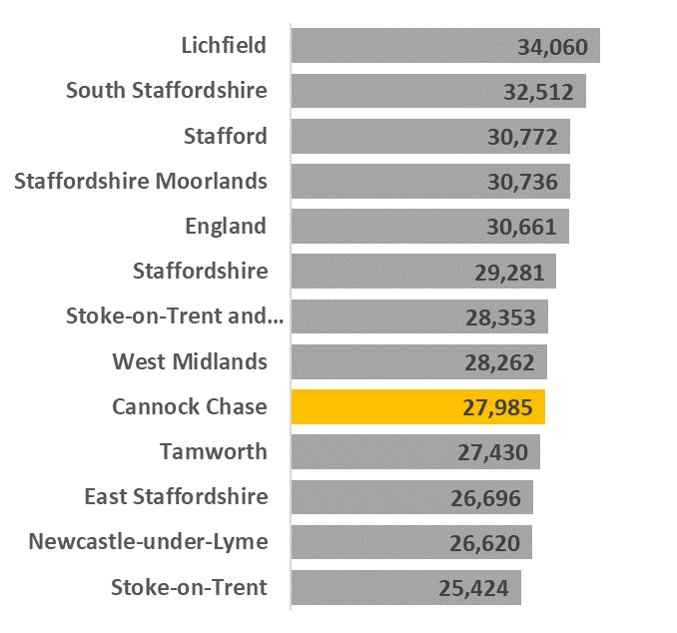
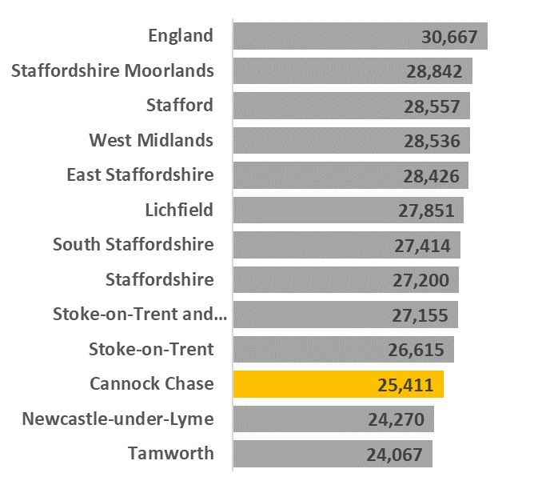
Cannock Chase also lags behind the national average for wages despite seeing improvement since the recession
Resident Earnings
Faster growth than nationally in resident earnings but slower growth in workplace earnings since the recession, and still well below the national averages
Workplace Earnings
Notes:
Earnings (2019):
Resident earnings now stand at £27,985 and have grown by £4,931 or 21.4% since 2009 – larger proportional growth than nationally (17.3%) but still below the national average of £30,661
Workplace earnings are currently £25,411 and have grown by £3,497 or 16.0% since 2009 – indication of better paid jobs in Cannock Chase which is likely to be a key factor in the growth of resident earnings – but slower growth than nationally (17.3%) and still well below the national average of £30,667
Particularly low female earnings compared to national averages
(Source: Annual Survey of Hours and Earnings (ASHE) 2019)

Slide 9
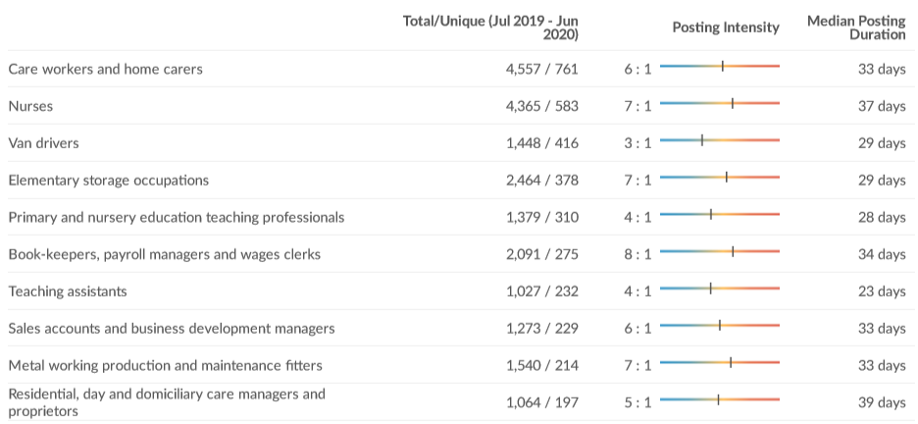
Job Vacancies in Cannock Chase
Over 10,600 job vacancies over the last year (July 2019-June 2020)
Median Advertised Salary = £23.5K
Main occupations in demand include:
Notes:
(Source: EMSI)

Slide 10
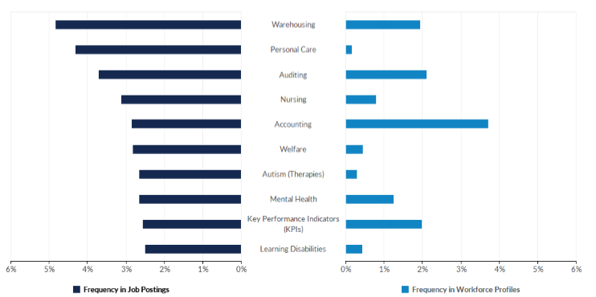
Hard Skills in Demand in Cannock Chase
Hard Skills most requested over the last year (July 2019-June 2020)
Notes:
The following provides insight into the supply and demand of relevant skills by comparing the frequency of skills present in job postings against skills present in today's workforce. Along with Emsi's job posting analytics, this comparison leverages Emsi's dataset of more than 100M online resumés and proﬁles. All resumés and proﬁles used in these comparisons have been updated within the last three years.
*The skills associated with workforce proﬁles represent workers of all education and experience levels.
(Source: EMSI)

Slide 11
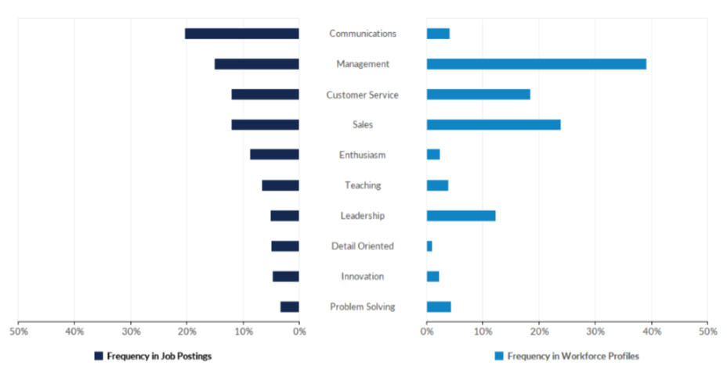
Common Skills in Demand in Cannock Chase
Common Skills most requested over the last year (July 2019-June 2020)
Notes:
The following provides insight into the supply and demand of relevant skills by comparing the frequency of skills present in job postings against skills present in today's workforce. Along with Emsi's job posting analytics, this comparison leverages Emsi's dataset of more than 100M online resumés and proﬁles. All resumés and proﬁles used in these comparisons have been updated within the last three years.
*The skills associated with workforce proﬁles represent workers of all education and experience levels.
(Source: EMSI)

Slide 12
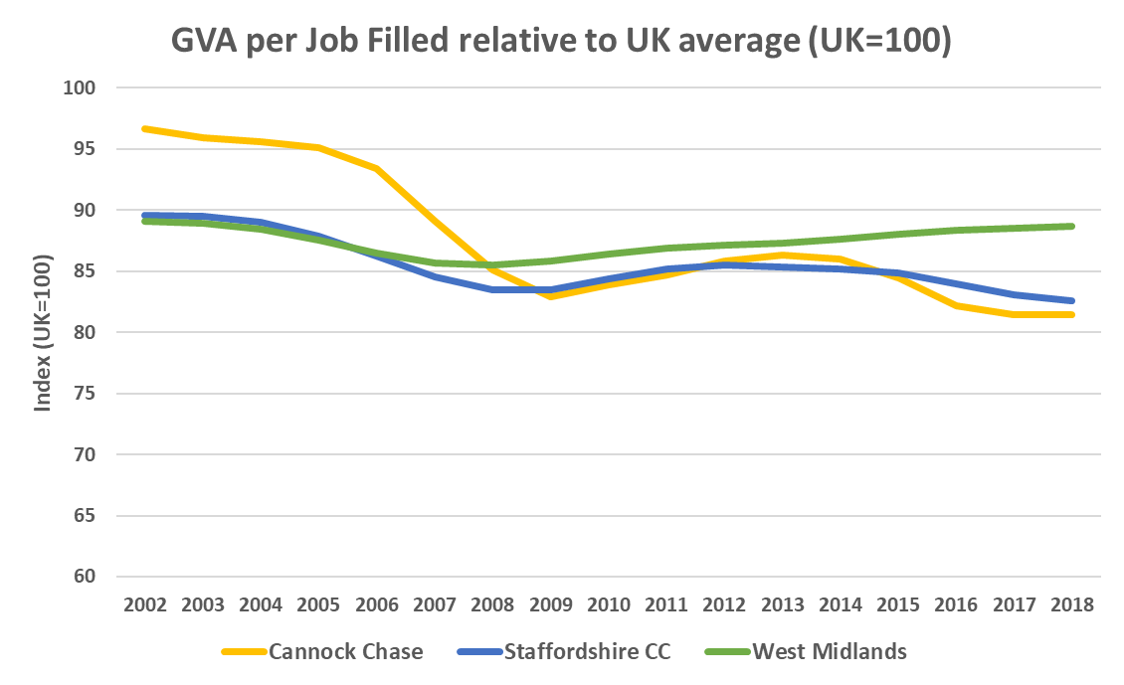
Raising productivity remains one of our biggest challenges
  GVA per job filled in Cannock Chase stood at £45,910 in 2018 compared to the UK average of £56,387 – nearly a fifth less productive
  Cannock Chase ranked 4th out of 8 Staffordshire LAs for GVA per job filled
  Cannock Chase has an important role to play in improving overall productivity in the SSLEP area, and can build on recent success in bringing more higher skilled and higher value jobs to the local area
88.7
82.6
81.4
Notes:
(Source: ONS Subregional Productivity 2018)

Slide 13
Adult skills levels are improving particularly for residents with no qualifications but remains lower than other areas for higher skills
Notes:
(Source: Annual Population Survey 2019)
No qualifications: % of adults with no qualifications fell below the national average for the first time in 2015 and seen a 8,200 decline since 2014, now stands at only 3.4% compared to 7.5% nationally
NVQ Level 3: Since 2014, an additional 8,800 adults with L3+ qualification and gap to national average has closed, would now require an additional 1,800 people qualified to NVQ Level 3+ to reach the national average
NVQ Level 4: Strong improvement at L4+ with an additional 8,000 adults with such qualifications since 2014, however would require an additional 3,500 adults qualified to NVQ Level 4+ to reach the national average
SEP (2014-2030) - Phase 1 (2014-2018) - new EU ESF Skills Programme started in 2014
Strategic focus on high value high skilled jobs in high-tech industries to help drive economic growth and raise productivity, alongside inclusive economic growth where everyone can benefit from growth in the economy
In order to attract better paid jobs in high value sectors there is a need to improve education and skills in the local area to deliver more higher skilled workers to fill these roles
Adult NVQ Levels - highest educational qualifications of the population
Growth in NVQ3+ and NVQ4+ with a reduction people with no qualifications for Cannock Chase – potentially linked to the new EU ESF skills programme investment of £55m (since 2014 to 2020)

Slide 14
Developing local skills is a key priority in addressing the productivity challenge and ensuring more residents can access more good jobs…
KS4: Generally Cannock Chase performs well at Early Years, but KS2 and KS4 remains and area for improvement performing the 2nd lowest for Attainment 8 out of all Staffordshire LA’s and significantly worse than the national average – inequalities at locality level with wide range in attainment
Pupil Absence/Exclusions: Cannock Chase has a higher than average proportion of children who are absent or excluded from school
KS5: Cannock Chase also performs poorly at KS5 with the second lowest Average Point Score (APS) per Level 3 Qualification of all Staffordshire LA’s and significantly worse than the national average
Higher Education: Participation in HE is far lower in Cannock Chase (26%) than the Staffordshire (35%) and national (37%) averages, associated to KS4 underperformance and lower levels of FE progression
Notes:
(Source: Staffordshire County Council 2019)
Focus now on further raising skill levels to support growth in high value, locally important sectors and raising productivity, whilst increasing wages and reducing demand for our services

